Slide 1
VIP 2.0
Team Members:
Tiago Moore, Victoriano Vega, Steven Rowe,
Jorge Perez, Andres Villa, Miguel Conde, Rodolfo Viant Product Owner:
Masoud Sadjadi Instructor:
Masoud Sadjadi
School of Computing and Information Sciences Florida International University
Senior Project Final Presentation Spring 2016
3/7/2016
Notes:
Greet your audience, thank them for attending your presentation, introduce yourself, introduce your project, introduce your team members, and quickly indicate what each of you did in a high-level manner, and put more emphasis on your part/contribution.

Slide 2
Problem Definition
Our Project
Mobile Judge is a web application that is built more for mobile devices to be the primary use. Mobile Judge is the application that judges will be using to score students during the senior project showcase.
Current Problems
Lacked the ability to accept/reject grades
View/update user profile page
Ability for admin to filter email selections
Social media account linking
Pagination on all grids
Export grades/judges
Import Students
Manage Student/Judges information
My Part
Admin being able to Manage student and judges information
User being able to view and update personal information
Notes:
Introduce the problem that the whole project tackles and stay focused on the parts that you have been working. Indicate if there is an existing previous system, enumerate its problems/limitations, etc.

Slide 3
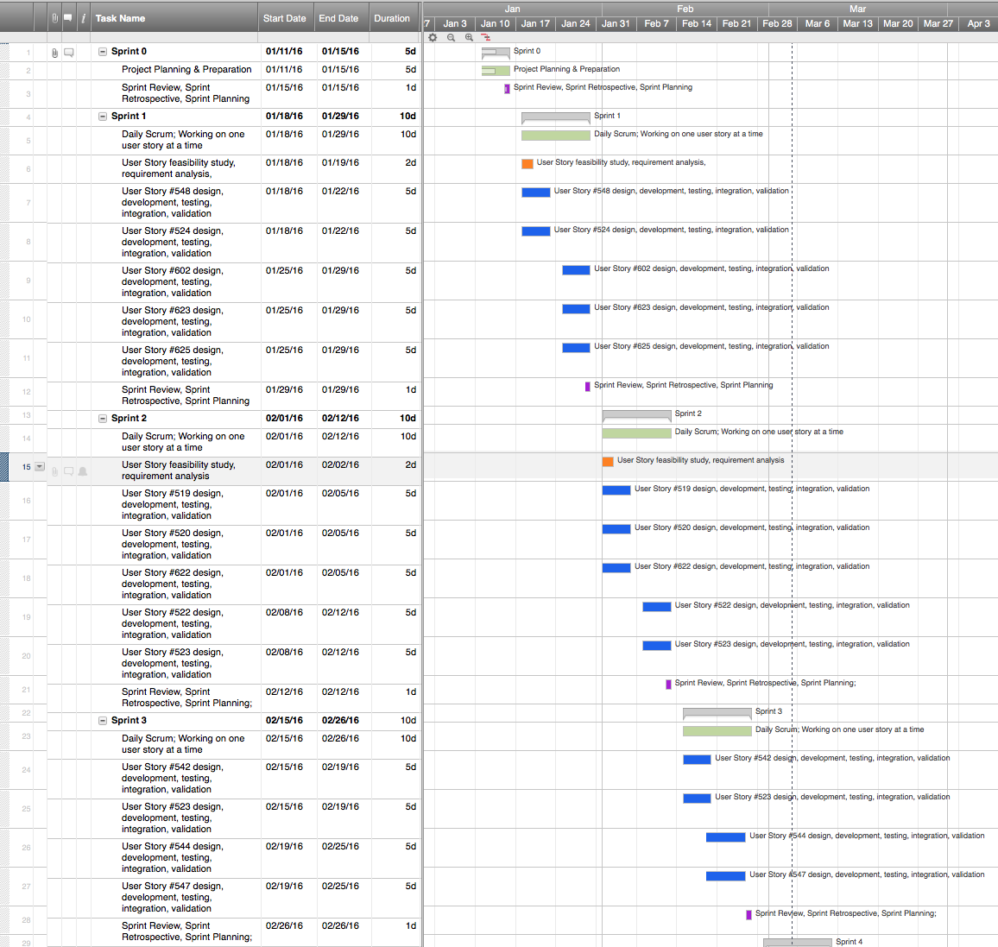
Project Management
Notes:
Project Management (schedule for entire semester) (one slide; Gantt Chart).

Slide 4
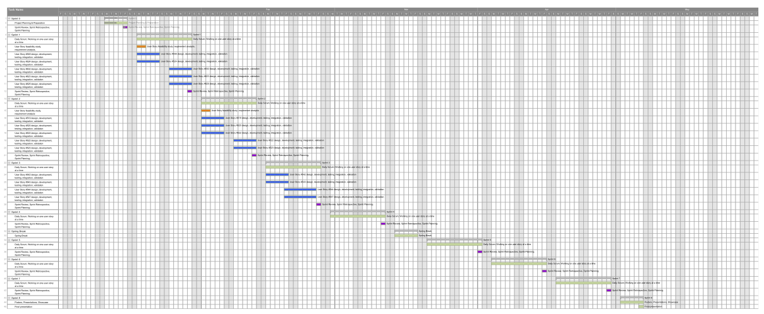
Full Gantt chart

Slide 5
Requirements: User Stories
#520-Manage User Profile
#543-Manage Judges
#544-Manage Student
Notes:
4. Requirements:
4.1. User stories implemented (one or more slides).
4.2. UML use cases and the use case diagram for the implemented use cases (one or more slides).
4.3. UML sequence diagrams for the implemented use cases.

Slide 6
Requirements: Use Cases
Use Case ID: MJ520 - Manage Profile
Details:
Actor: User
Pre-conditions:
Once user is logged in, the user profile information is loaded onto the screen
Description:
Use case begins when the user clicks his profile picture or name
The system will redirect the user to his profile page
Once redirected to the his/her profile page, all the profile information will be able to be edited.
The system will be able to save the new profile information changes.
Use case ends once the user clicks save.
Post-conditions:
n/a
Alternative Courses of Action:
n/a
Notes:
Introduce the problem that the whole project tackles and stay focused on the parts that you have been working. Indicate if there is an existing previous system, enumerate its problems/limitations, etc.

Slide 7
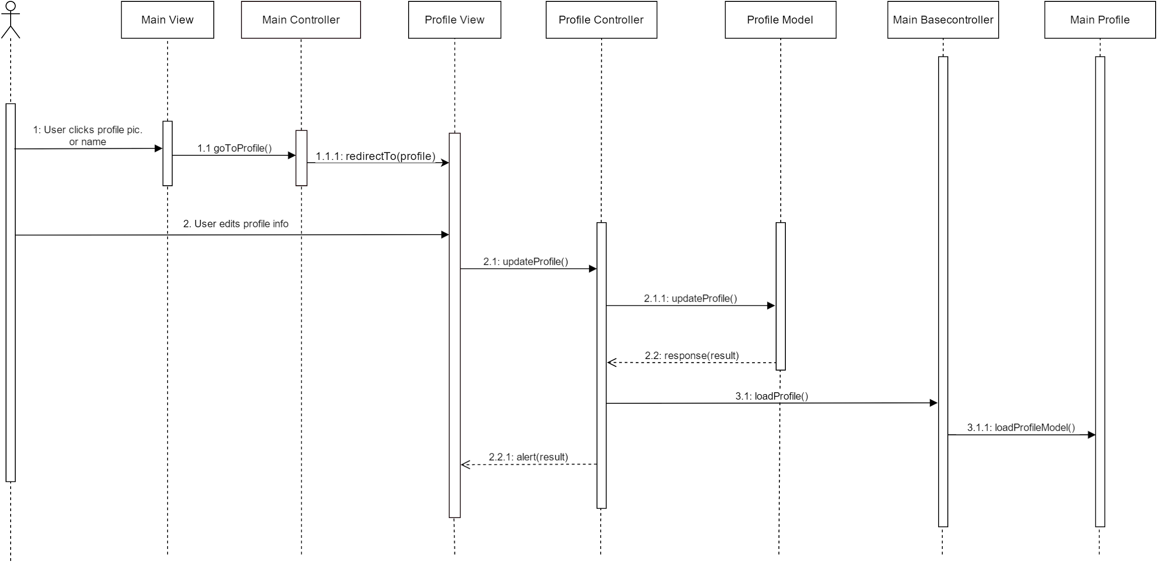
Requirements: Sequence Diagrams
#520-Manage User Profile
Notes:
4. Requirements:
4.1. User stories implemented (one or more slides).
4.2. UML use cases and the use case diagram for the implemented use cases (one or more slides).
4.3. UML sequence diagrams for the implemented use cases.

Slide 8
Requirements: Use Cases
Notes:
4. Requirements:
4.1. User stories implemented (one or more slides).
4.2. UML use cases and the use case diagram for the implemented use cases (one or more slides).
4.3. UML sequence diagrams for the implemented use cases.

Slide 9
System Design: Architecture
3-tier architecture and Client-Server
Security/Privacy
Oauthd authentication
Hashing and salting of passwords
Sanitizing user input
Token based authentication (bcrypt)
Notes:
5. System design:
5.1. System decomposition; identify the architecture patterns used (one slide).
5.2. System deployment – h/w and s/w requirements (one slide).
5.3. Persistent data design (one slide).
5.4. Security/Privacy (one slide).

Slide 10
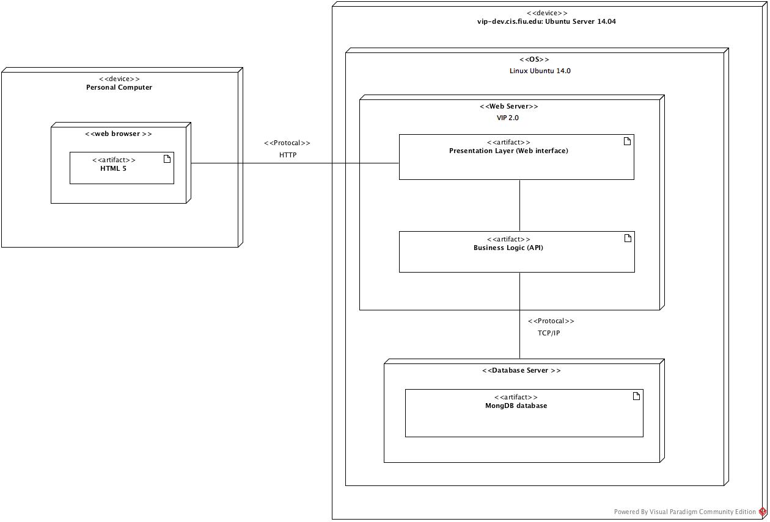
System Design: Deployment
Notes:
5. System design:
5.1. System decomposition; identify the architecture patterns used (one slide).
5.2. System deployment – h/w and s/w requirements (one slide).
5.3. Persistent data design (one slide).
5.4. Security/Privacy (one slide).

Slide 11
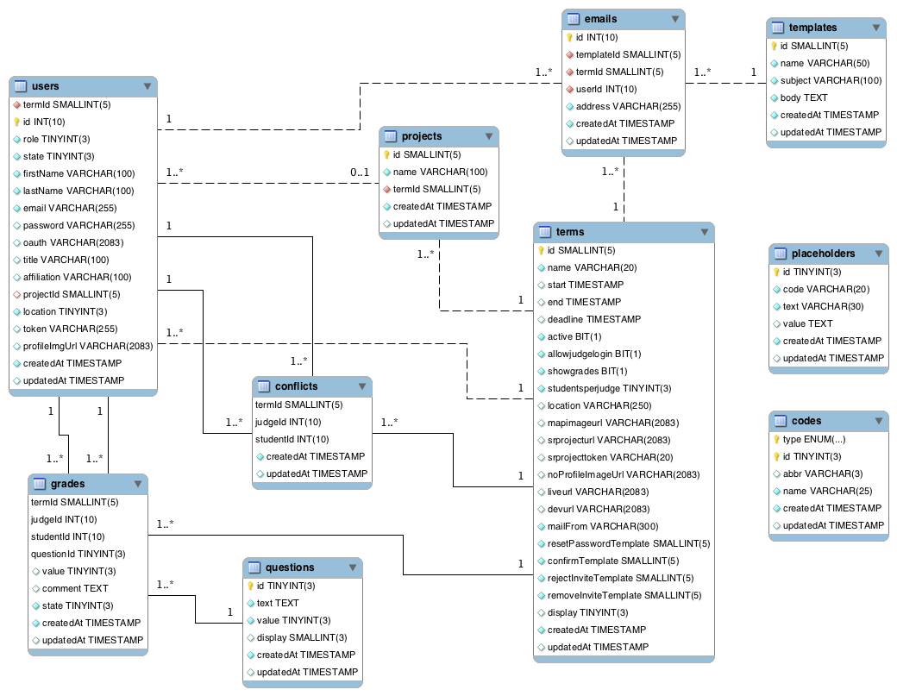
System Design: Persistent data design
Notes:
5. System design:
5.1. System decomposition; identify the architecture patterns used (one slide).
5.2. System deployment – h/w and s/w requirements (one slide).
5.3. Persistent data design (one slide).
5.4. Security/Privacy (one slide).

Slide 12
Minimal Class Diagram
Notes:
6. Detailed design:
6.1. Minimal class diagram. Identify the design patterns used (one or more slides).
6.2. State machine for the main control object or the most important object of the implemented uses cases (one or more slides).
6.3. Main algorithm used related to an implemented use case described above (one or more slides).

Slide 13
Test Cases (Sunny Day)
ID: MJ-SD-520-01
Purpose
Test if user can save new information
Precondition
User has logged into Mobile Judge
User went to his/her profile page by clicking on his/her picture or name
Expected Result
User was able to save all information on the form
Actual Result
User was able to save all information on the form to the database
Notes:
7. Test Suites and Test Cases (one sunny day and one rainy day) for the use case represented in part (5) above (2 slides).
7.1 One sunny day and one rainy day for the implemented use cases (one or more slides).
7.2 Automated test scripts for the implemented use cases (one or more slides).

Slide 14
Test Cases (Rainy Day)
ID: MJ-RD-520-01
Purpose
Test if user can save first name, last name or email with empty fields
Precondition
User has logged into Mobile Judge
User went to his/her profile page by clicking on his/her picture or name
Expected Result
User was not able to save first name, last name, or email fields information to database
Actual Result
User was able to save all information on the form to the database
Notes:
7. Test Suites and Test Cases (one sunny day and one rainy day) for the use case represented in part (5) above (2 slides).
7.1 One sunny day and one rainy day for the implemented use cases (one or more slides).
7.2 Automated test scripts for the implemented use cases (one or more slides).

Slide 15
Thank you!
Contact information:
Steven Rowe email: mrowe009@fiu.edu
Notes:
Summarize your contribution
Include your contact information
Ask if anyone has any questions for you.
Thank your audience

